Slide 1


Business Analyst Career
Program - Capstone Project
By-Rohit Kumar

Slide 2
Agenda:-
● Data Exploration
● Graphical Analysis using Excel
● Insert the given data into the SQL server
● Import the Data from the SQL Database into PowerBI
● Interactive Dashboard by using visualization tools
● Conclusion and Inferences
● Endnotes

Slide 3
Data Exploration:-
This excel sheet include 701 row and 16 column that include western countries it is noted that financial data.
In this excel sheet there were many segment ,country ,product,gross sales ,sales,unit sold,manufacturing price,etc which related to the business.
In this sheet the gross sales of government segment is more than all other segment that is 42.86%.
The product name Paseo sales more than other product and least is carretera and montana.
it is also noted that overall profit is not affected when discount is allowed on the product.
The largest sales show in the month of october.
The more profit shows in the product name Paseo.
The gross sales of all country are almost same.

Slide 4
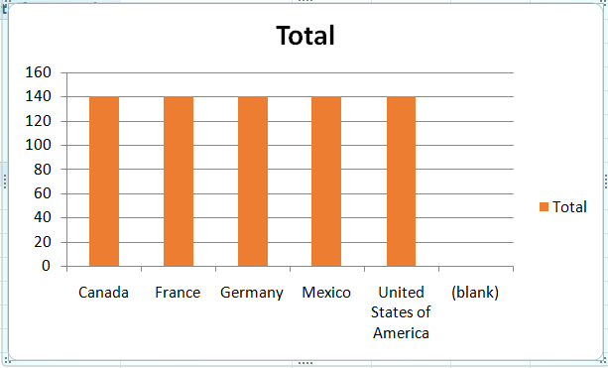
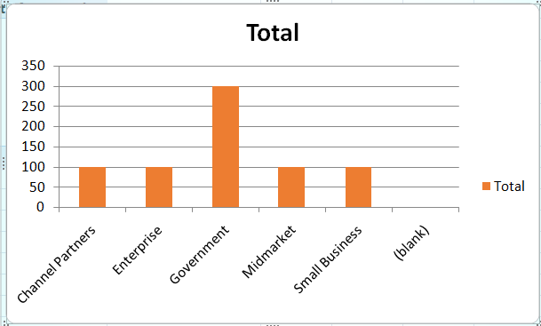
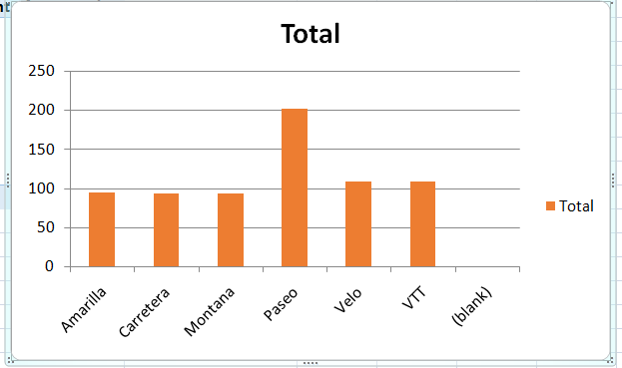
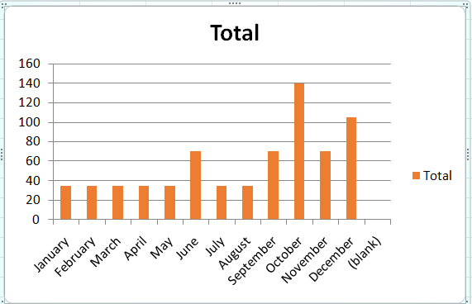
Graphical Analysis using Excel:-
Country wise sales Segment wise sales
Product wise sales Month wise sales

Slide 5
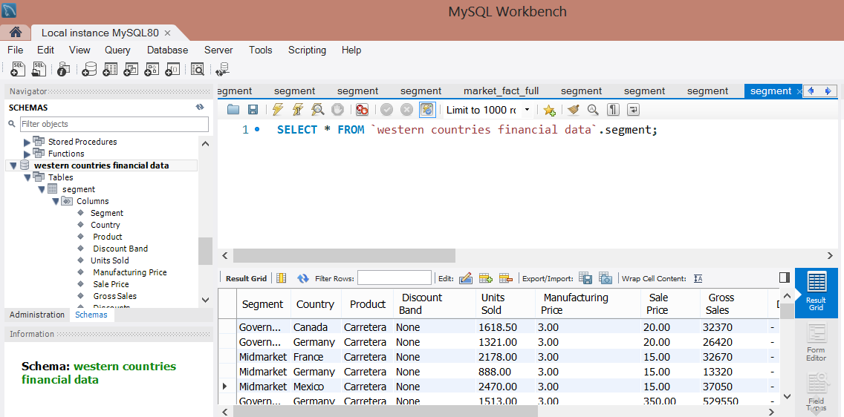
Insert the given data into the SQL server:-

Slide 6
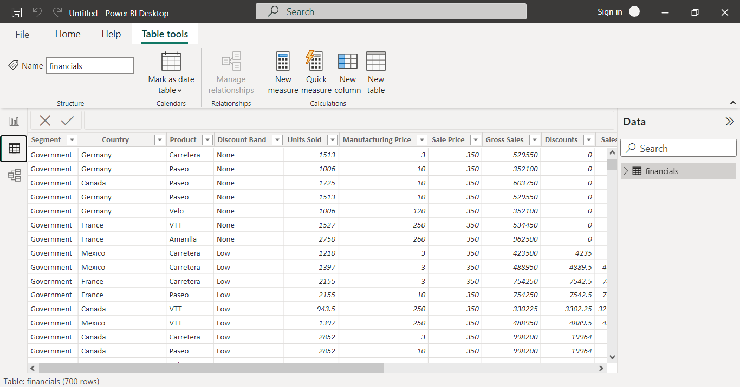
Import the Data from the SQL Database into PowerBI:-

Slide 7
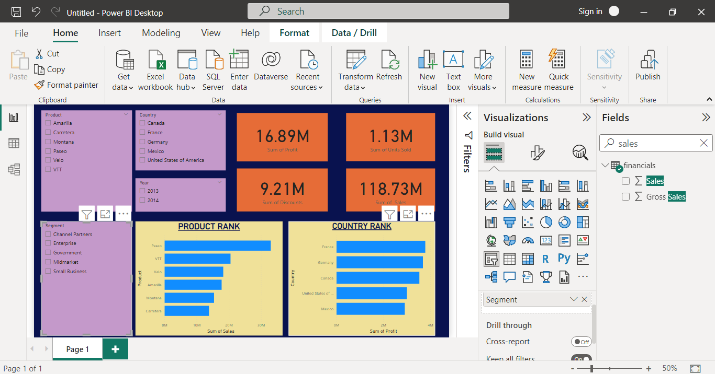
Interactive Dashboard by using visualization tools:-

Slide 8
Conclusion and Inferences:-
The product name Paseo sales more than other product and least is carretera .
In this sheet the profit of government segment is more than all other segment that is 11.39 M.
Yearly sales of 2013 is26.42 M and yearly sales of 2014 is 92.31.
The united states of america has a highest numbert of sales that is 25.03 M.
Yearly profit of 2013 is 3.88 M and Yearly profit of 2014 is 13.02M.
Top two countries are France and Germany which gives more profit on selling product.
Three bottom product which sales are low is Amarilla,Montana,carretera.
The product name carretera has least discount and Paseo has more discount.
The number of unit sold in the year 2014 is more than 2013.In 2013 the number of unit sold are 264.67K and the number of unit sold in 2014 is 861.13K.
The profit on product name Paseo is more and least in carretera.

Slide 9
Endnotes:-
(1)Download the Western Countries Financial Data Dataset from here:-
https://drive.google.com/uc?export=download&id=1J8LoZ-9c3XHXpiIfZfKd7DPjFomaX78t
(2)To view Power Bi files click below file:-

